Slide 1
Bumble Bee
Yeo Shu Xian 0308455 (Leader)
Goh Yi Yan 0314826
Lee Shin Wei 0309999
Lee Joe Ann 0301658
Yong Chun Khuen 0303038
Research Topic: Layout Design Concept
(Photobucket, 2014)

Slide 2
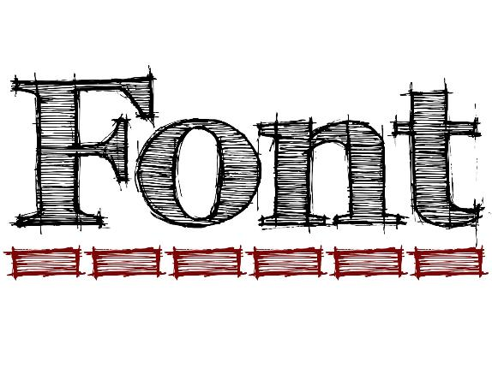

Slide 3
Font and the spacing between letters can impact how reader feel when reading on a website.
(Image taken from huffpost.com, 2014)

Slide 4
Effects of good fonts
Higher cognitive focus
More efficient mental processes
A stronger sense of clarity

Slide 5
Well-designed reading environments don’t necessarily help you understand what you’re reading better, but they
Make you feel good
Feel inspired
More likely to take action.

Slide 6
How we read
When we read, our eyes follow a natural pattern called a Scan Path.
(Image taken from medium.com, 2013)
We break sentences up into scans (saccades) and pauses (fixations).

Slide 7
Our eyes typically move across a page for between 7-9 letters before needing to pause to process what you’re reading.
As you scan a sentence, no useful visual processing is happening in your brain.
Visual processing is completely dependent upon the information taken in when you pause.

Slide 8
How to design better website……Using font.

Slide 9
1) Choose an anchor font
Selecting a typeface for the content that is most prevalent in your project
This will be the typeface that you base your other font decisions on like headlines and subheads

Slide 10
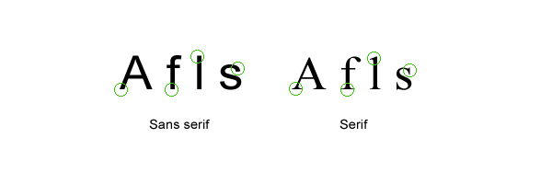
Serif Fonts — Letters with short lines coming off the edges. Viewed as more formal and traditional. Best suited for print.
Sans-serif Fonts — Letters without serifs. Viewed as informal and playful. Best suited for digital.
(Image taken from medium.com, 2013)

Slide 11
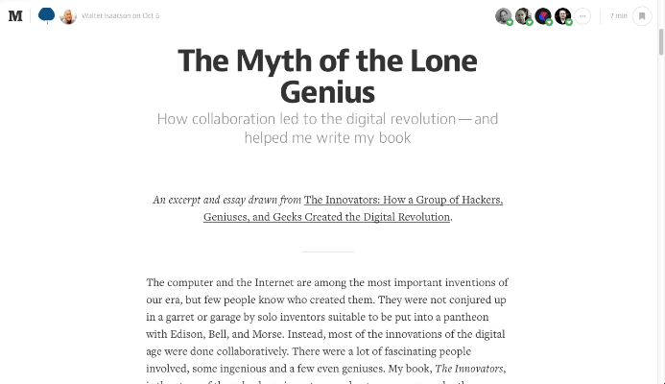
When choosing a font for body text for website, it’s usually best to stick with a Serif font or Sans-serif font.
(Screenshot of medium.com, 2014)
An example of a website using only Serif font and Sans-serif font.

Slide 12
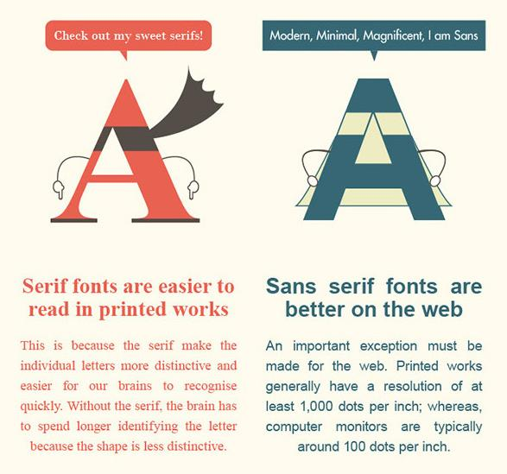
(Image taken from
webdesignerdepot.com, 2013)

Slide 13
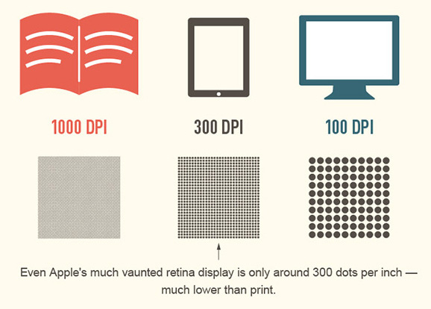
(Image taken from webdesignerdepot.com, 2013)

Slide 14
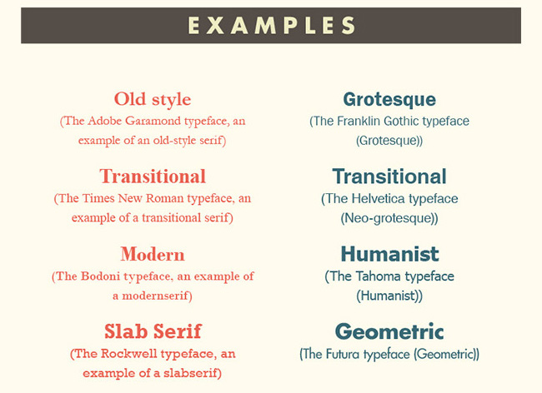
(Image taken from webdesignerdepot.com, 2013)

Slide 15
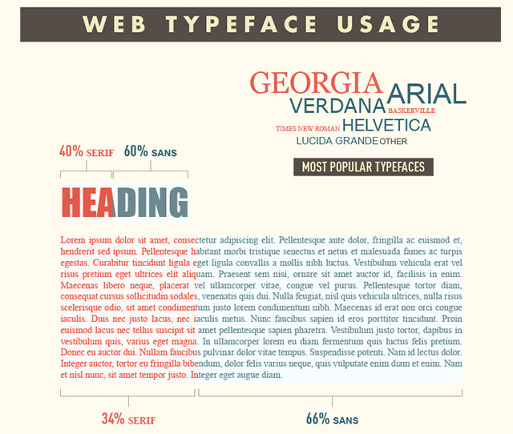
(Image taken from webdesignerdepot.com, 2013)

Slide 16
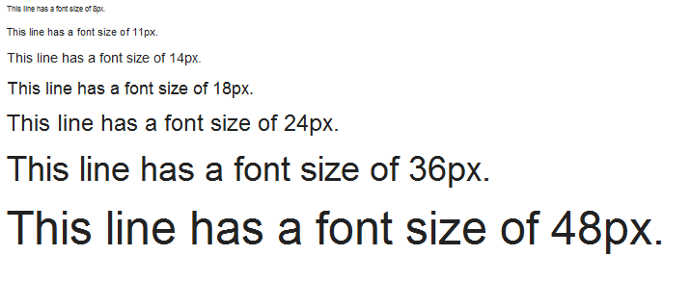
2) Pick a font size bigger than 12pt
(Image taken from cksource.com, 2013)
As digital and screen resolutions improve, many designers mention that 16px font is the ideal size for website font.

Slide 17
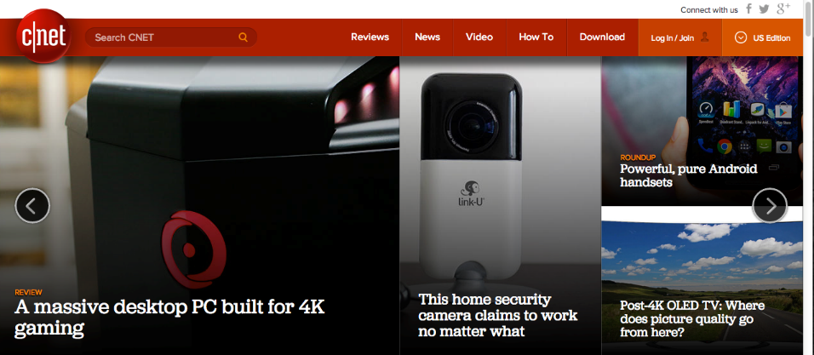
A recent study has also shown that larger font sizes can elicit a stronger emotional connection.
(Screenshot of cnet.com, 2014)
A website using larger font sizes to attract the attention of reader to click into their featured story.

Slide 18
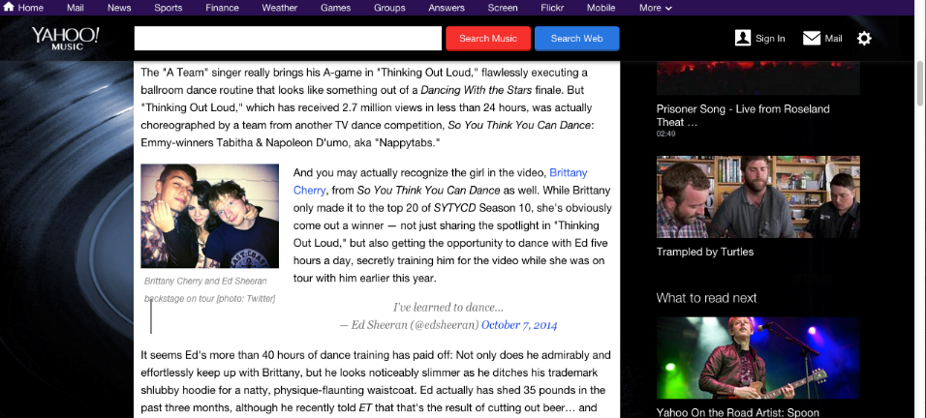
While having a huge font over 30px most likely wouldn’t make sense, many blogs have font in the 10px-12px range.
Yahoo Music Blog
(Screenshot of music.yahoo.com/blog, 2014)

Slide 19
3) Watch your line length
Line length is how far the sentences stretch across the page.
The ideal line length should be between about 50-75 characters.
If the line length is too short, reader’s rhythm will break because their eyes must travel back to the left of the page too often.

Slide 20
A line length that is too long makes it hard to find where lines of text start and end. It can make it difficult for reader to get to the next line without accidentally jumping to the wrong place.
Research shows that subconscious mind gets a boost of energy when jumping to a new line (as long as it doesn’t happen too often) but this energy dwindles as readers read over the duration of the line

Slide 21
This line length has been shown to be most effective in helping readers move through their Scan Path.
(Image taken from medium.com, 2013)
It’s 78 characters, about 6.5 inches.

Slide 22
4) Mind your spacing
Adequate spacing between letters is important for readers to be able to move through sentences fluidly.
The tighter the letters are together, the harder it is for people to identify the shapes that make up different letterforms

Slide 23
Here’s an example from Jessica Hische of the readability of Helvetica versus Avenir. Hische recommends Avenir because of its more open spacing:
(Image taken from medium.com, 2013)

Slide 24
The best font choices are ones where readers do not notice the font but the message.

Slide 25
LAYOUT
is the sizing, spacing, and placement of contents in design.

Slide 26
Features of An Effective
Website Layout

Slide 27
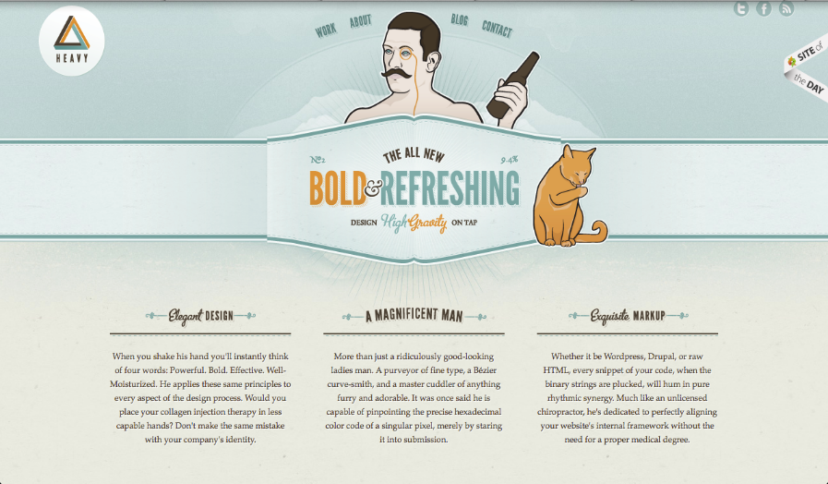
FOCUS
showing users what need to look first
(Screenshot of foreverheavy.com, 2011)
Good Example : Users will first focus on the center which contains the tagline of the company.

Slide 28
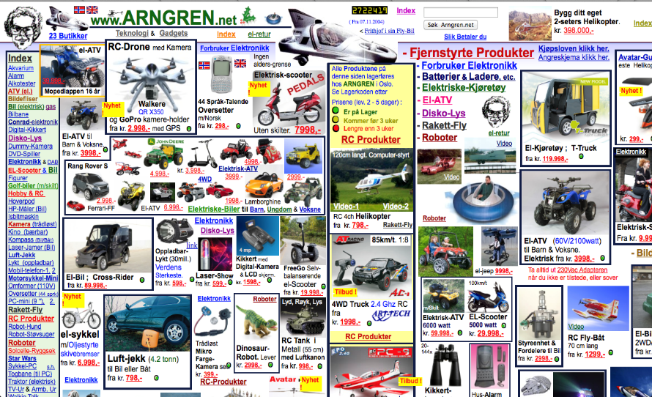
yvettesbridalformal.com
yvettesbridalformal.com
(Screenshot of arngren.net , 2004)
Bad Example : Users wouldn’t know where and what to look first.

Slide 29
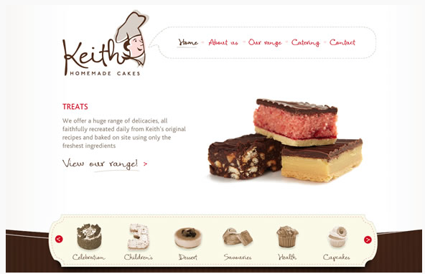
FLOW
Ability to create a clear path through the surface, leading the user’s eye to flow smoothly for easier search of elements they need.
(Screenshot of keithcakes.com.au, 2014)

Slide 30
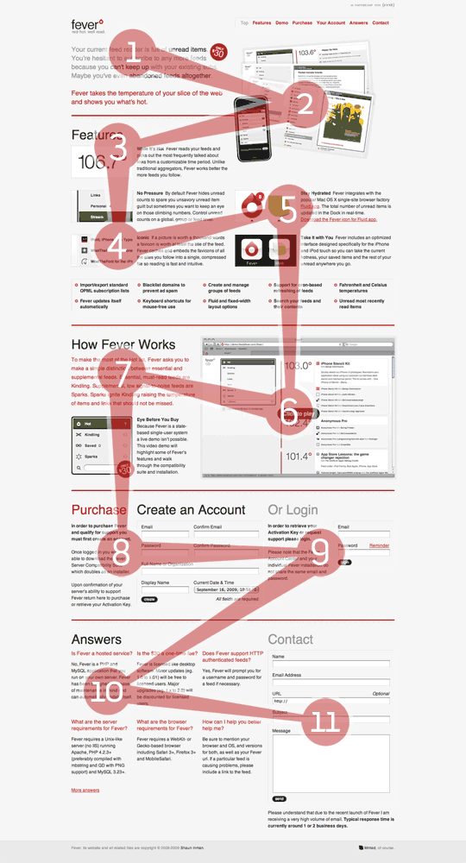
As you can see in the annotated screenshot on left, there is a natural reading down the page. This is great as users are more likely to see all the content and less likely to miss important information.
Notice the use of images to draw the attention of the visitor towards the next section which can be seen in points 2, 3, 4, 5 and 6.
The use of typography helps take the user to the next sections as seen in 3, 7, 8 and 10.
The horizontal red lines help to define sections creating a natural reading order Â from left to right.
(Screenshot of inspectelement.com, 2009)

Slide 31
GROUPING
Content and elements that are related to each other are grouped together while unrelated contents are separated.
(Screenshots of webdesignerdepot.com, 2010)
The contents on the left is not cluttered but the elements are not logically grouped, so the effect is weak.
The grouping of elements in the contents on the right is more logical and has a more pleasing visual effect.

Slide 32
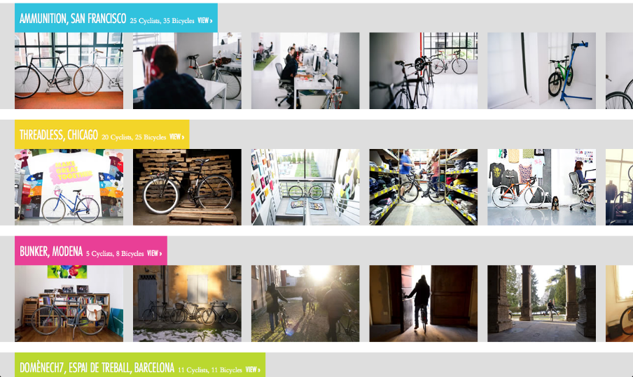
(Screenshot of theworkcycle.com, 2011)
Good Example: Related contents are well grouped together.

Slide 33
(Screenshot of arngren.net , 2011)
Bad Example : Contents are scattered all over the webpage without proper grouping of contents.

Slide 34
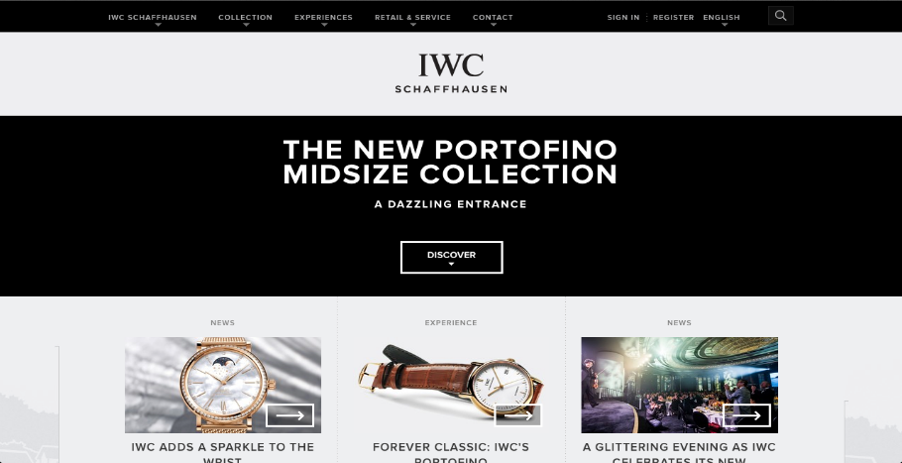
EMPHASIS
Different content and elements are highlighted according to their relative importance by the size, colour contrast and placement.
(Screenshot of iwc.com, 2010)
Good Example : By using the colour contrast of the banner, it has highlighted and attract users about the new collection of the brand.

Slide 35
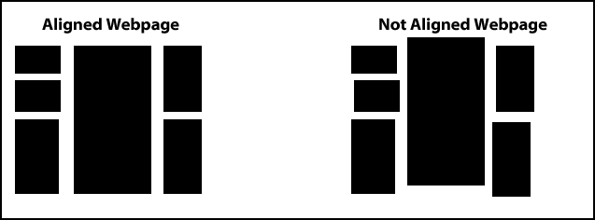
ALIGNMENT
Elements are arranged accordingly and orderly for easier access.
(Screenshot of webmastericons.com, 2012)

Slide 36
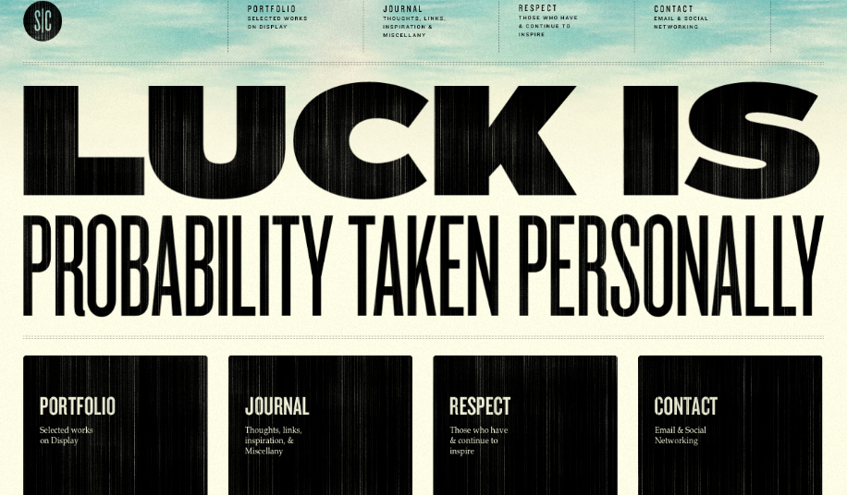
(Screenshot of stephencaver.com, 2009)
Good Example : The navigations and descriptions are properly aligned. Some spaces are left in between to create a clean alignment.

Slide 37
(Screenshot of siphawaii.com, 2007)
Bad Example : The texts and contents are badly aligned. It looks jarring and unpleasant to users’ eyes.

Slide 38
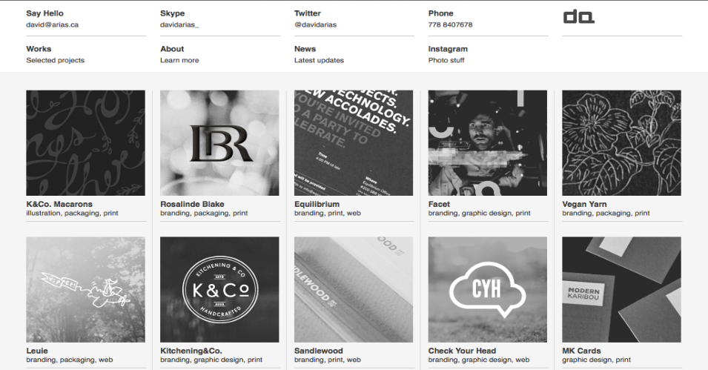
Consistency
Pages with similar content uses similar page layout in order to create uniformity.
(Screenshot of arias.ca, 2010)
Good Example : The colour tones and alignment of the contents are uniformed and consistent throughout the webpage.

Slide 39
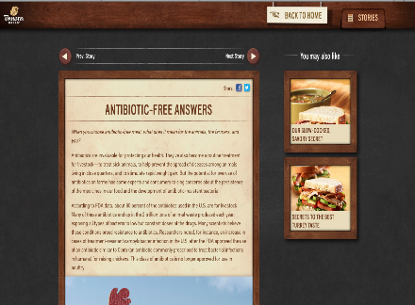
Good Example : The elements of website layout design are consistent as it uses the same element repeatedly throughout different pages of website.
(Screenshots of panerabread.com, 2013 )

Slide 40
WHY WEBSITE LAYOUT IS IMPORTANT ?
It’s the facade of the company.
It will show the brand/company identity.
Determines the kind of experience that users will have when they pay a visit to the site.
Enhance the aesthetic of the entire group of projects.
Help keep your visitors interested.
It can makes the website attractive even without attractive graphics

Slide 41
Functional > Design
Function should always take precedence over design.
Internet users know that they are free to navigate away from a website that doesn’t provide useful and claimed information.
There are no definitive right or wrong ways of approaching website layout !
Just make sure that the layout works for the site that you are designing.

Slide 42
What about Colors?

Slide 43
Based on the article,
A good website design determine on the choice of COLORS or else it is either boring and plain or too “bright” that cause unpleasant sight for viewers.
Colors are important!
However, appropriate usage of colors need to take into consideration.
Article :“Find Out What Colors Will Cause Your Visitors to Hate You”

Slide 44
Know your colors well !
Before making the choices of your color.

Slide 45
What ?
Warm colors
Red Orange Yellow
Vivid & energetic
Tend to advance in space
Cool colors
Blue Green Purple
Impression of calm, create a soothing impression

Slide 46
Neutral
Black
White
Grey
Mix & Match with
others color schemes.
(Warm & Cold)

Slide 47
Color is a Non-verbal Communication
Choose the right color to communicate effectively for your website design to grab your viewers’ interest.

Slide 48
RED
Color of energy, passion, action and determination.
ORANGE
Color of social communication and optimism.
YELLOW
Color of the mind and the intellect- Optimistic and cheerful.
GREEN
Color of balance and growth.
BLUE
Color of truth and peace.

Slide 49
PURPLE
Color of imagination.
PINK
Color of unconditional love and nurturing.
WHITE
Color of perfection, the most complete and pure.
BLACK
Color of hidden, secretive, unknown and mystery.

Slide 50
Examples of good website design (Color)

Slide 51
For this website, the color of black and red compromised and brings the effect strong impact between the mixture of neutral and warm color schemes. Based on the color psychology, red and black brings out the energy, action and hidden mysterious emotion that will keep the viewers to stay on the site or even purchase the product.
Warm & Neutral
(Image from Onextrapixel, 2014)

Slide 52
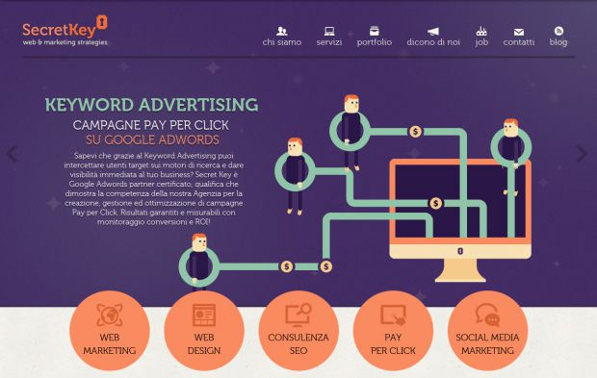
Cool & Warm
(Image from Nice One, 2014)
For this website, it used the triadic color scheme. Good combination of warm and cold color (Purple, orange and green) harmonies well. Purple as the domain. Viewed with fun and imaginary outlook.

Slide 53
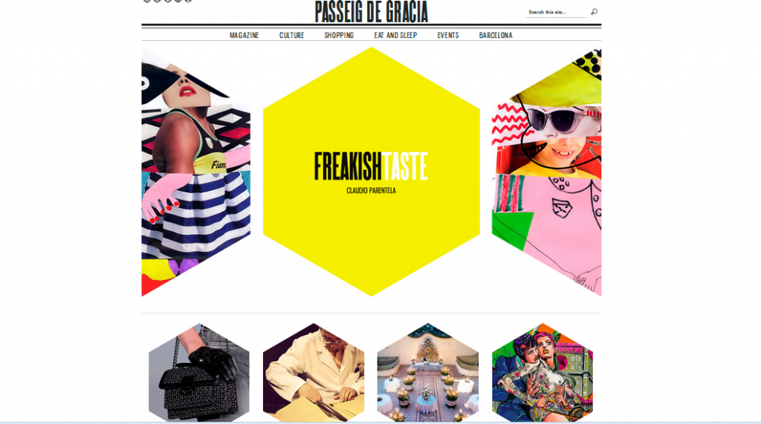
Neutral & Warm
(Image from Smashing Hub, 2013)
For this website, it focuses on the black, white and grey which are neutral scheme.
However, the yellow in the middle made a stand alone and the immediate focus of viewer’s eyes is on it.
Making use of the balance of color schemes to effectively attract viewers.

Slide 54
Examples of bad website design (Color)

Slide 55
YOU WOULD NOT WANT TO SEE SOMETHING LIKE THIS, RIGHT ?
( Layoutsparks, n.d.)

Slide 56
(Image from Janine C., 2013)
Penny & Juice
Colors are not harmonized, rainbow color effect is not a good choice. Bright color background does not go well with colorful texts. Too many colors blended in one design. Visitor may lose the focus and misleading by the colors of what this site is all about. The red and yellow should be used adequately.

Slide 57
(Image from Markus Design Works, 2014)
Pizza & Pasta
Color coordination is bland and dull. Color visualization is not appealing, one color stanza. Color harmony needs to be consider in order to know which scheme is suitable to create a more tempting site, for example, food.

Slide 58
(Image from Altplus, 2009-2014)
L.A. Eyeworks
Background should avoid bright series of color, it may irritate the viewer’s eyes.
The font color, white and black are overshadowed by the background color.

Slide 59
Color is important!
I agreed that the statement regarding color does play an important part in website design. The choices of color that placed in each components will affect the whole if one color is out, for example, red background with yellow font color. Used a solid color as a domain, determine on the color schemes and color harmony that one’s want to apply will lead to a good start for website design. Font color should be The color plays a part in determining the success or failure of a site. So, choose the color carefully.

Slide 60
Navigation

Slide 61
Navigation
Definition of navigation
A field of study that focus on the process of monitoring and controlling.
The movement of a that brings them from one place to another.
To make sure the correct path way from one places to another.

Slide 62
Navigation
To determine of position and direction.
A skill to lead some message to perform in a right way.
This also practice of navigating, especially the charting of a course for a ship or aircraft.

Slide 63
Navigation
Navigation means providing in directing and participating in plotting , Below were a few where navigation usually appear on daily life
Navigating a ship
Navigating a aircraft
Navigation a car
Navigating a person to reach their needs

Slide 64
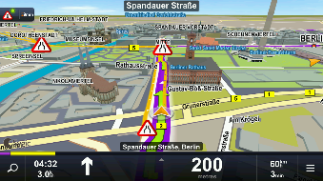
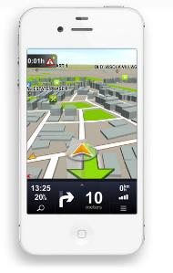
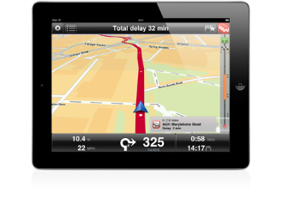
Navigation
In a new generation that filled with Technology would have generate navigation machines.

Slide 65
Navigation
Other than just using a tool, web page would also navigate their customer properly.
According to the Navigation article that provided. To navigating their consumers reach product service at what they are looking for. By :
Stating the logo or name of your company at the top right side come along with your page name.
- This would clearly shown the customers where they are and which web page they were in. A clear location and direction must provided.

Slide 66
Navigation
2. Provide a clear navigation button
- This could help to ensure the customers understand the flow of the web-page. Other than that it would avoid them being confuse about the lay out, in the same time would increase the effectiveness of customers reach their needs and wants.

Slide 67
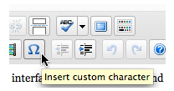
Navigation
There were few characteristics of a successful navigate on webpage.
Clear
This was the most important element in webpage in order to let customers clearly know why and where they were.
(Screen shoot from usabilitypost.com, 2009)
A short explanation of the function would provide the audience a clear explanation

Slide 68
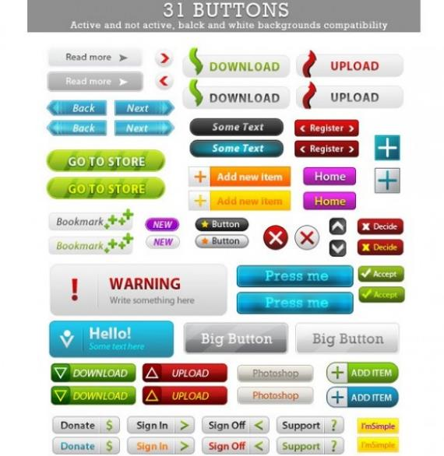
To perform a clear navigation button colour is important !!
(Images from ipsdtemplate.com)

Slide 69
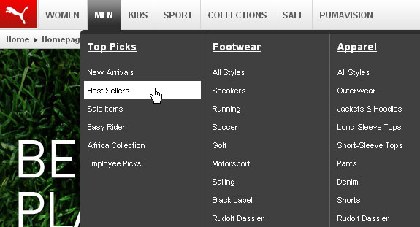
Navigation
4. Ensure every button where link correctly.
{As the article of navigation has mention that user will be frustrating to click on a page that they just visited}
Although you may have a lots of link but stated them clearly is necessary.
(Image taken from a1javascripts.com, 2010)

Slide 70
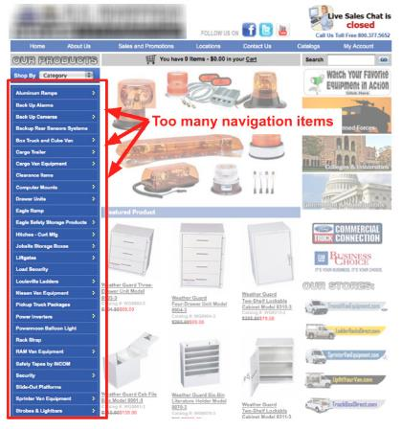
Navigation
Example of a bad navigation button and the arrangement caused user confuse
https://blog.kissmetrics.com/wp-content/uploads/2013/01/4-long-side-navigation.jpg

Slide 71
Navigation
Conclusion
Navigation meaning that to successfully lead the user to the destination or answer the question that they seek for.
I agreed to the article which stated that navigation should always answer the question “Where am I?” we cant sure that the user will follow he sequence that arranged. Instead, we should always makes our thing clear and direct to avoid them confuse in our web-page.

Slide 72
References
Altplus, 2014, ‘l.a. Eyeworks’, viewed 9th October 2014,
http://altplus.net/2014/03/000138.php
Bonshoff, J., 2009, ‘The importance of website design & layout’, viewed on 6th October 2014, http://www.trafficbrand.com/the-importance-of-website-design-layout/
Bulat, A, ‘Font Psychology: What Your Font Says About Your Website’, viewed 8th October 2014, http://blog.templatemonster.com/2012/05/16/font-psychology/
Coffin, D., 2014, ‘Learning from Bad Web Design’, viewed on 6th October 2014, http://webmarketingtoday.com/articles/learning-from-bad-web-design/
Cho, M, Fonts have feelings too, viewed 8th October 2014,
https://medium.com/.../fonts-have-feelings-too-1523564d966c
Foreverheavy.com, 2014, Greensboro NC Professional Web Design and Development: Forever Heavy, viewed 6th October 2014, http://foreverheavy.com
Hische, J, ‘Upping Your Type Game’, viewed 8th October 2014,
http://jessicahische.is/talkingtype

Slide 73
Inspectelement.com, 2014, Inspect Element - Web Design & Development Blog, viewed 6th October 2014, http://inspectelement.com
Janine C., 2013, ‘Web Design: Good and Bad Website Design’, viewed 9th October 2014, http://janinecoviello.wordpress.com/2013/09/11/web-design-project-one-good-and-bad-website/
Kenny, T., 2009, ‘The Principles of Good Web Design Part 1: Layout’, viewed on 6th October 2014, http://inspectelement.com/articles/the-principles-of-good-web-design-part-1-layout/
Kole, S, ‘Serif vs. Sans: the final battle’, viewed 8th October 2014, http://www.webdesignerdepot.com/2013/03/serif-vs-sans-the-final-battle/
Keithcakes.com.au, 2014, Birthday Cakes, Desserts, Pies & Savouries, Muffins and Catering | Keith Homemade Cakes, viewed 7th October 2014, http://keithcakes.com.au
Larson, K & Picard, R, ‘The Aesthetics of Reading’, viewed 8th October 2014, http://affect.media.mit.edu/pdfs/05.larson-picard.pdf
Lazaris, L., 2010, ‘The Principle of Proximity in Web Design’, viewed on 8th October 2014, http://www.webdesignerdepot.com/2010/01/the-principle-of-proximity-in-web-design/

Slide 74
Microsoft, ‘Scan Path’, viewed 8th October 2014,
http://www.microsoft.com/typography/ctfonts/wordrecognition.aspx%20-%20use%20skitch%20to
%20point%20to%20points%20of%20fixation
Markus Design Works, 2014, ‘Price of Bad Website’, viewed 9th October 2014,
http://markusdesignworks.com/wp-content/uploads/2012/06/316.png
Nice One I Like, 2014, ‘Web Design Marketing and SEO- Secret Key Agency’, viewed 8th October 2014,
http://www.niceoneilike.com/best-website-inspiration/Web-Design-Marketing-and-SEO---Secret-Key-Agency
Onextrapixel, 2014, ’40 Stunning Website Design with Great Color Schemes’, viewed on 8th October 2014,
http://www.onextrapixel.com/2013/10/25/40-stunning-website-designs-with-great-color-schemes/
Pallasart Web Design, 1996-2014, ‘Making Effective Use of Color in Website’, viewed on 8th October 2014,
http://www.pallasweb.com/color.html
Smashing Hub, 2013, ’14 cool hexagon web design’, viewed 8th October 2014,
http://smashinghub.com/14-cool-hexagon-web-design.htm
Tiger Color, 2000-2012, ‘Basic color schemes- Introduction to Color Theory’, viewed 8th October 2014,
http://www.tigercolor.com/color-lab/color-theory/color-theory-intro.htm
The importance of attractive website layout, n.d., Jet Peppers Blog, viewed on 6th October 2014,
http://jetpeppers.com/the-importance-of-attractive-website-layout/

Slide 75
Theworkcycle.com, 2014, The Work Cycle | Home, viewed 6th October 2014,
http://theworkcycle.com
Understand the Meaning of Colors in Color Psychology, 2009-2014, viewed on 8th October 2014,
http://www.empower-yourself-with-color-psychology.com/meaning-of-colors.html
‘WHY LAYOUT IS IMPORTANT IN DESIGN?’, 2012, Arfa Technologies, viewed on 7th October 2014,
http://arfatechnologies.com/graphic-design-blogs/why-layout-is-important-in-design/#more-21

